Slide 1
Task 2: Simulating Race Attack
Group 2

Slide 2
What is Race Attack?
The attacker has a small amount of bitcoin they intend to use in two conflicting transactions.
1) The attacker prepares two transactions:
Transaction A: The first transaction sends bitcoin to the merchant for goods or services.
Transaction B: The second transaction sends the same bitcoin to another address controlled by the attacker.
2) Initiate the Attack: The attacker simultaneously broadcasts both transactions to the Bitcoin network:
Transaction A is sent directly to the merchant. The merchant sees this transaction as unconfirmed and assumes it will soon be confirmed in the blockchain.
Transaction B is broadcast to other parts of the network with a higher transaction fee than Transaction A, incentivizing miners to include it in the next block.

Slide 3
What is Race Attack? (contd.)
3) Merchant Delivery: The merchant, believing Transaction A is legitimate, delivers goods or services without waiting for a block confirmation (zero-confirmation transaction).
4) Mining and Double-Spending: Since Transaction B has a higher fee, miners are more likely to include it in the next block over Transaction A. If this happens, Transaction B will be confirmed in the blockchain, making Transaction A invalid (double-spending).

Slide 4
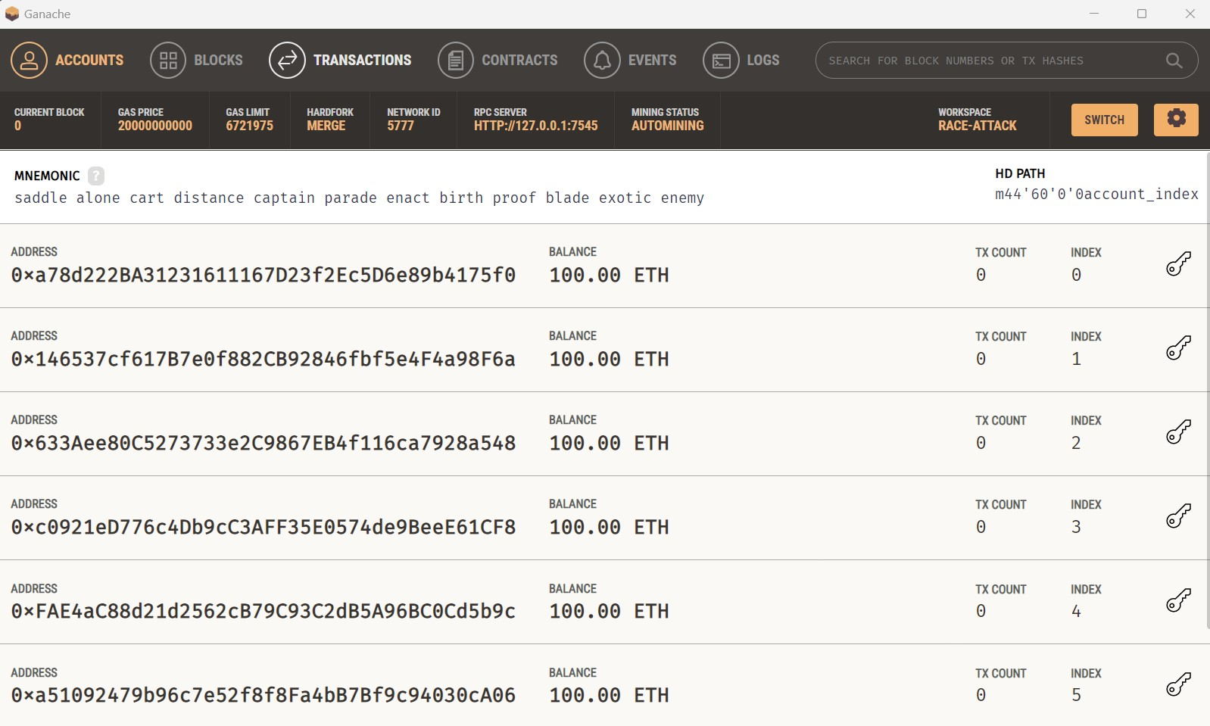
Beginning
Using Ganache (a personal Ethereum blockchain) as our “bank”, Solidity as our programming language and test Ethers as our currency, we try to simulate a Race attack.
As visible in the image, these are the accounts before any transactions or deployments have occurred. All the accounts have 100 test Ethers.

Slide 5
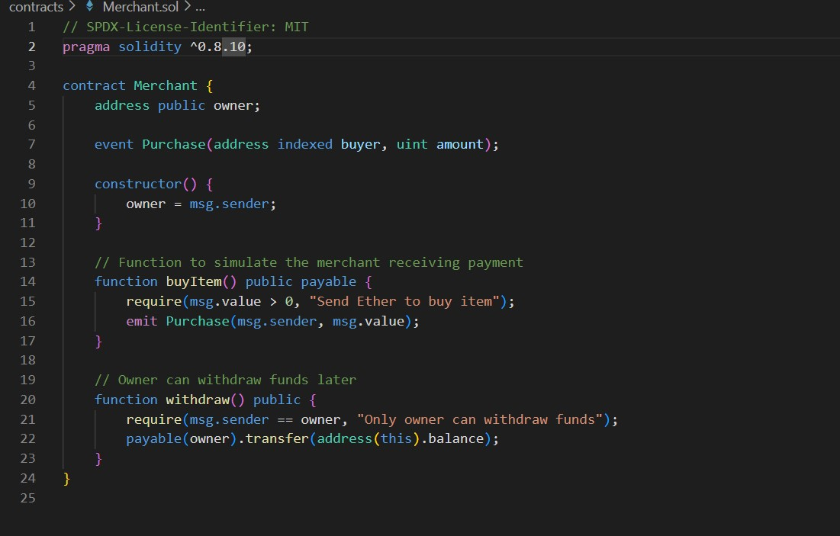
Solidity code
This is the solidity code that represents Transaction A, where the attacker sends Ether to the merchant’s smart contract using the buyItem() function.
The merchant logs the purchase but does not wait for a block confirmation, simulating a zero-confirmation transaction.

Slide 6
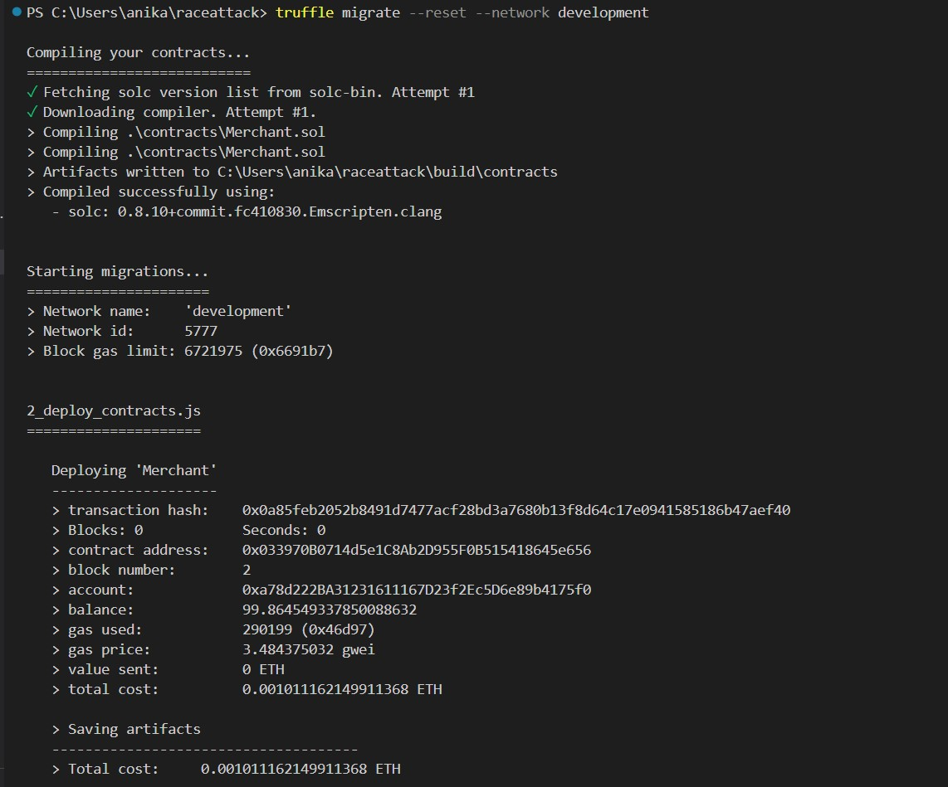
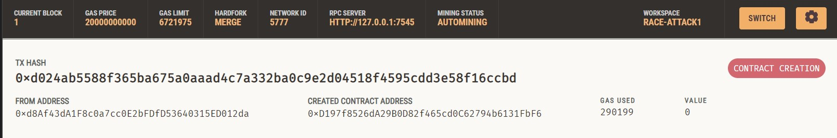
Deployment
We use the command truffle migrate –network development to deploy the Transaction A contract to Ganache.
We can see that a contract has been created in the “Transactions” tab, as Ganache(or any Etherum-like blockchain) treats deployment as a transaction.

Slide 7
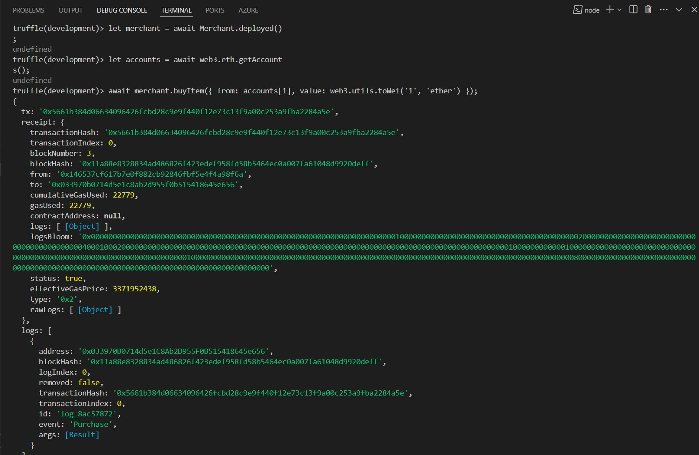
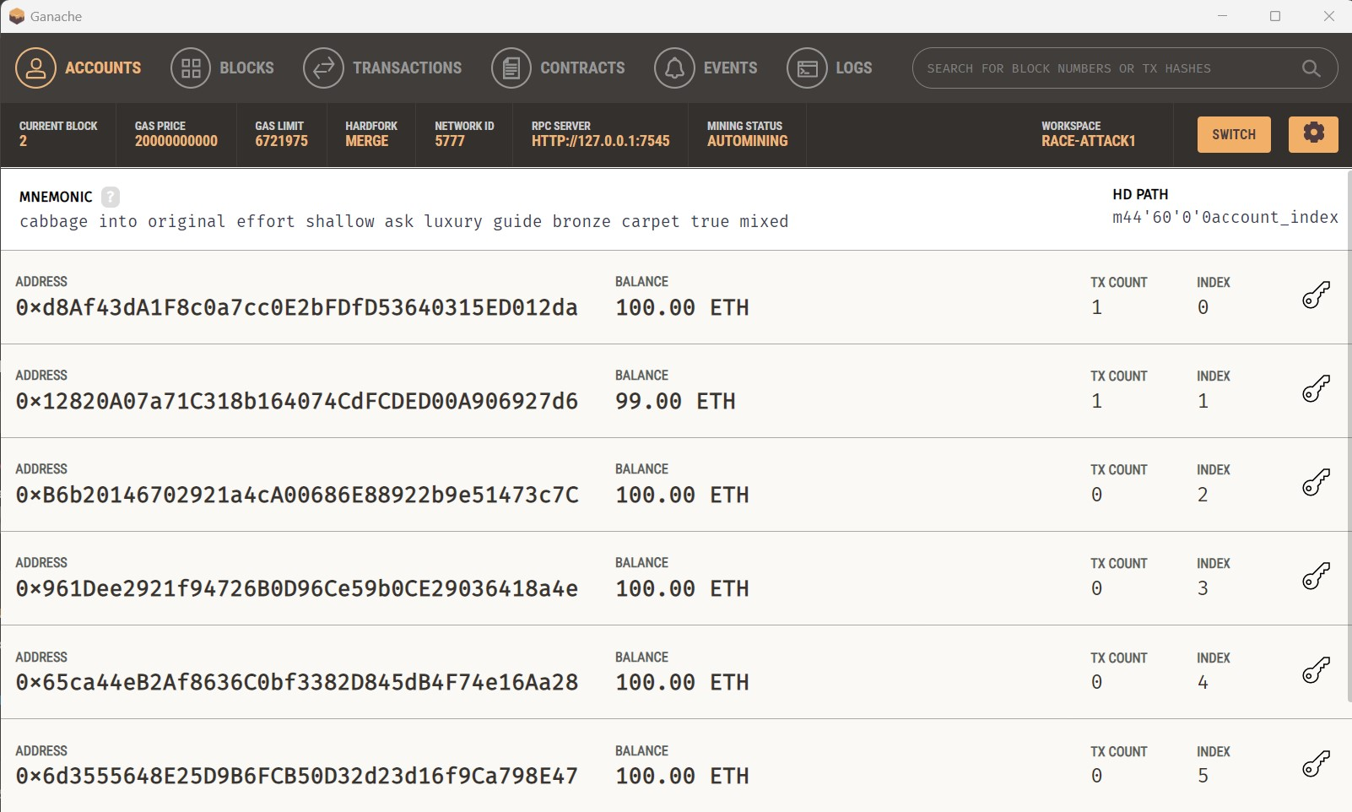
Transaction A
The image on the left shows the commands used to simulate Transaction A. The commands are explained in the next slide and are run through truffle console. As seen in the image on the right, 1 ETH is deducted from account 1 (the merchant’s account) to simulate “buying” goods from the merchant.

Slide 8
Transaction A – js codes
let merchant = await Merchant.deployed(); Gets the deployed contract
let accounts = await web3.eth.getAccounts();
Retreives the Ganache accounts
3. await merchant.buyItem({ from: accounts[1], value: web3.utils.toWei('1', 'ether') });
Executes buyItem function with 1 Ether from account [1] (the merchant’s account). This is Transaction A.
We (the attackers) have now “bought” goods from the merchant.

Slide 9
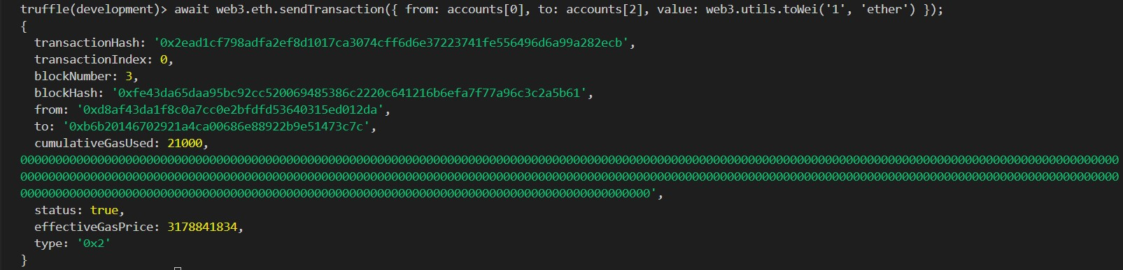

Transaction B – js codes
Now, in step 2 of a Race Attack, we create a second conflicting transaction. This involves sending Ether to another account that we control (account 2)
This is achieved with the following code that is run in truffle console:
await web3.eth.sendTransaction({ from: accounts[0], to: accounts[2], value: web3.utils.toWei('1', 'ether') });
As seen in the image, 1 Ether has been deducted from our account [0] and has been transferred to another account [2] that we control.

Slide 10
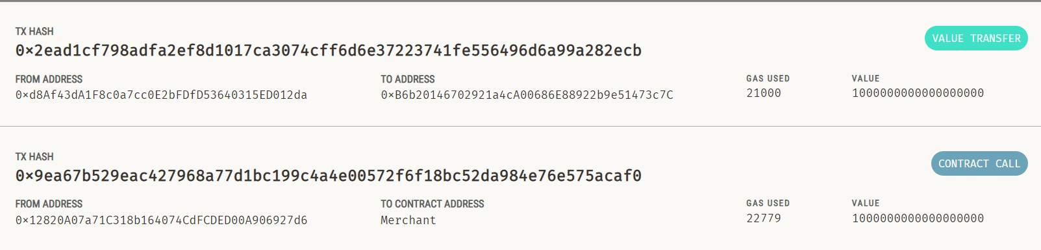
Transaction Details
As we can see, Contract Call refers to Transaction A, and Value Transfer refers to Transaction B. Value Transfer occurred after Contract Call, because we ran transaction B after A.

Slide 11
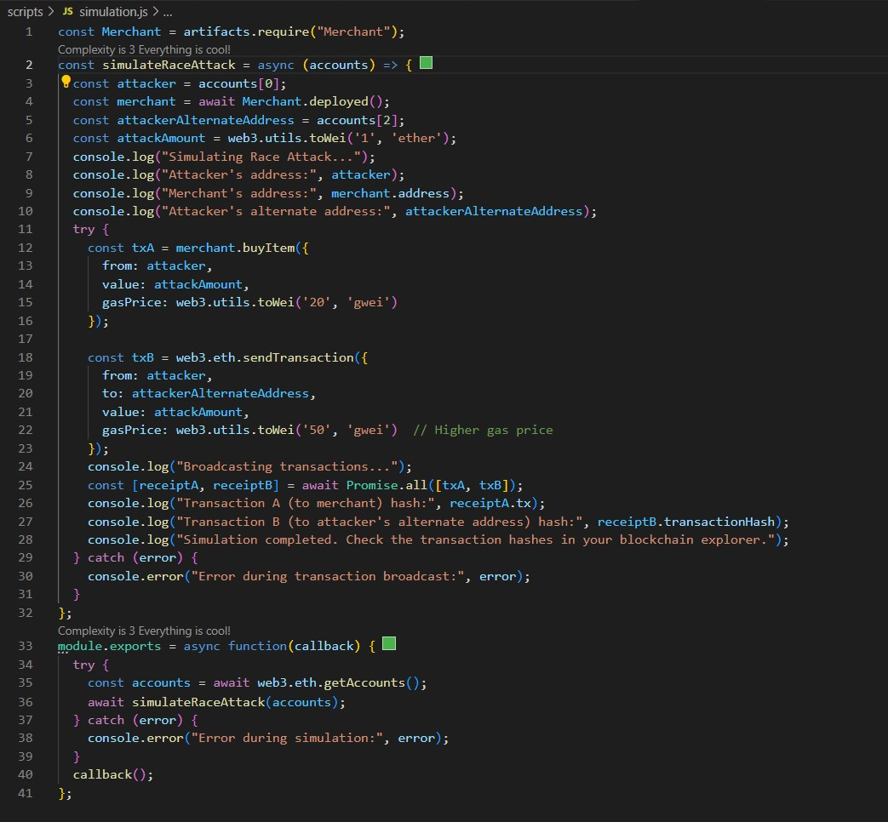
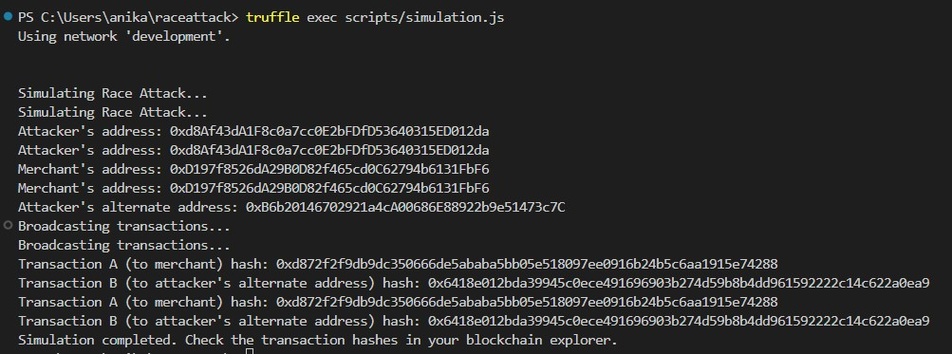
Simulating Race Attack
In order to finally simulate a Race Attack, we create a new file called simulation.js and enter the code (seen in the image).
This script deploys the merchant contract (if not already deployed), simulates sending two conflicting transactions simultaneously and prints out the transaction hashes. Transaction B is also assigned a higher gas price.
We run it using the command truffle exec scripts/simulation.js
The result is seen in the image below:

Slide 12
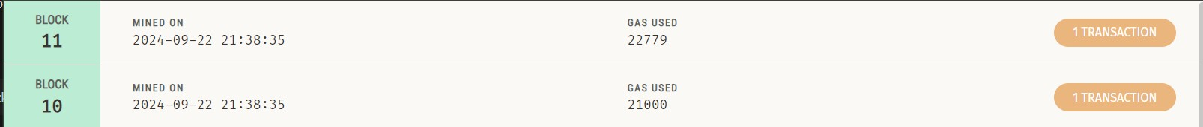
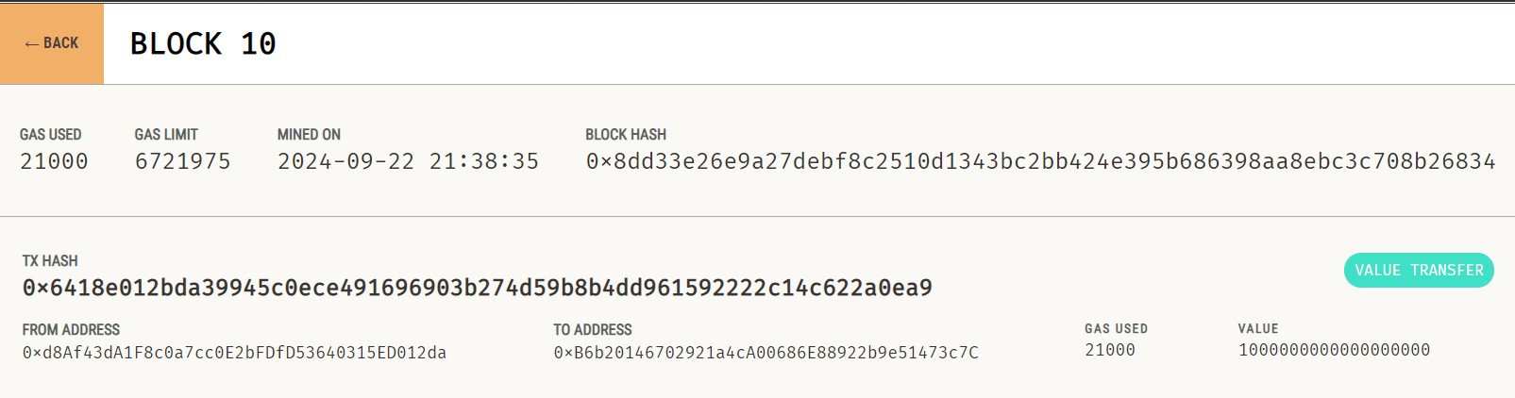
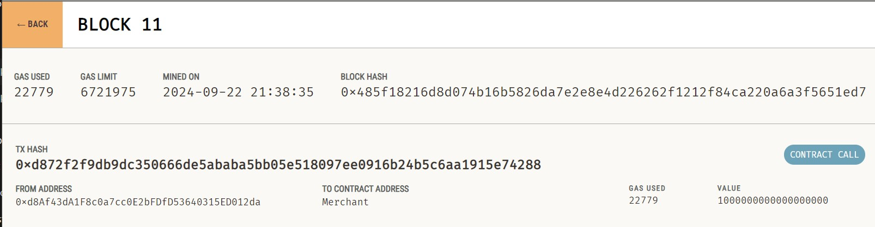
Result
As seen in the first image, both transactions A and B occurred simultaneously.
In the second image we see that Block 10 is Value Transfer. The “from address” hash is of acc[0] and the “to address” is of acc[2], proving that Block 10 ran Transaction B.
In the third image, Block 11 is a Contract Call from acc[0] to the Merchant, proving that it ran Transaction A.
Block 10 was processed before Block 11.

Slide 13
Result
This simulation aimed to demonstrate the concept of a Race Attack within a blockchain environment, where two conflicting transactions are broadcast simultaneously.
By executing Transaction A, which involved purchasing an item from a merchant, and Transaction B, which sent the same ether to an alternate address with a higher gas price, we aimed to replicate a real-life attack within the confines of our personal blockchain.
The results confirmed that Transaction B was prioritized and processed before Transaction A, effectively allowing the attacker to double-spend the ether. Block 10 (Transaction B) being processed before Block 11 (Transaction A) represents miners including a Transaction B (with the higher fee) in the next block over Transaction A, which leads to B being confirmed in the blockchain, making A invalid.

